Slide 1
PRESENTATION ON
STATIC PROJECT
Event Management System
By:
Aparna Mukrut
Guided By:
Jayanth V. Sir

Slide 2
Contents:
Introduction of Topic
Languages used
Screenshots
Conclusion

Slide 3
Introduction:
In this Static project I have design a static Website for Event Management System.
Different events like birthday, wedding ceremony, naming ceremony, get togethers with their package details are included.
In this I have used front end technologies like HTML5, CSS3, Bootstrap, Javascript.
There are different sections in navigation bar like home, about us, gallery, contact us, logout.
There is a login and sign up options for users.
User can book their event for particular day and time.

Slide 4
Languages Used:
HTML
HTML stands for Hyper Text Markup Language.
HTML describe the structure of a Web page.
HTML elements tell the browser how to display the
content.

Slide 5
Languages Used:
CSS
CSS stands for Cascading Style Sheet.
CSS describe how HTML elements are to be displayed .
CSS saves a lot of work. It can control the layout of
multiple web pages all at once.

Slide 6
Languages Used:
Bootstrap
Bootstrap language is a open source CSS framework.
It is used for attractive and responsive website.
It is flexible and easy to work with.

Slide 7
Languages Used:
JavaScript
Javascript is a scripting language.
It is mainly used for validation purposes.
It allows to add dynamic behaviour to the web page.

Slide 8
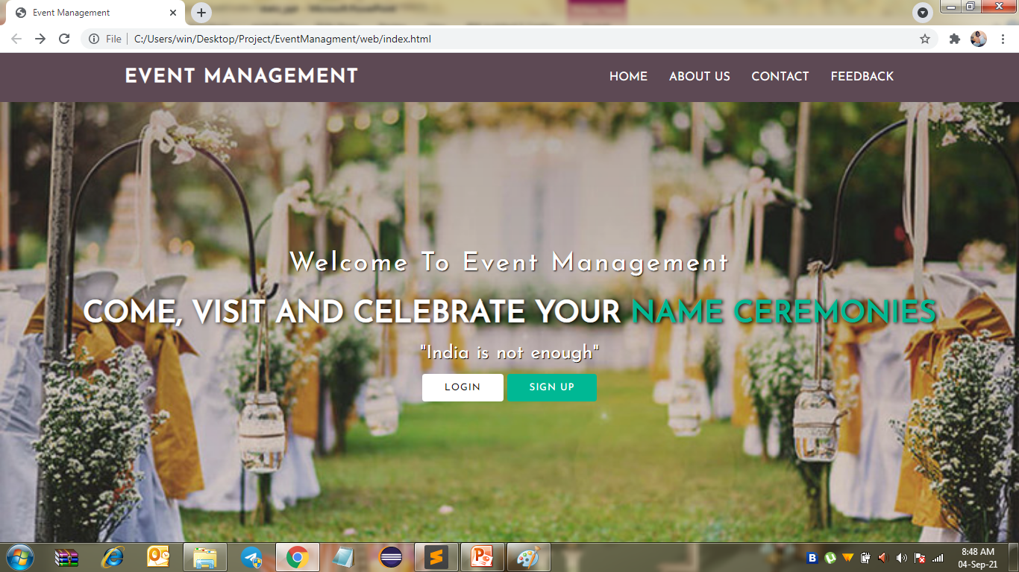
Index Page:

Slide 9
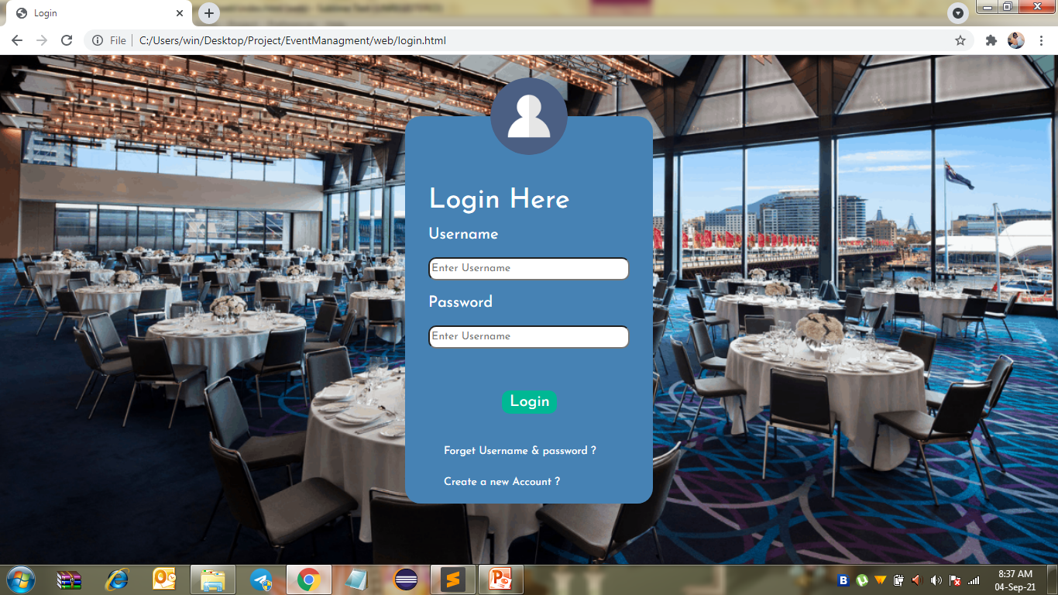
Login Page:

Slide 10
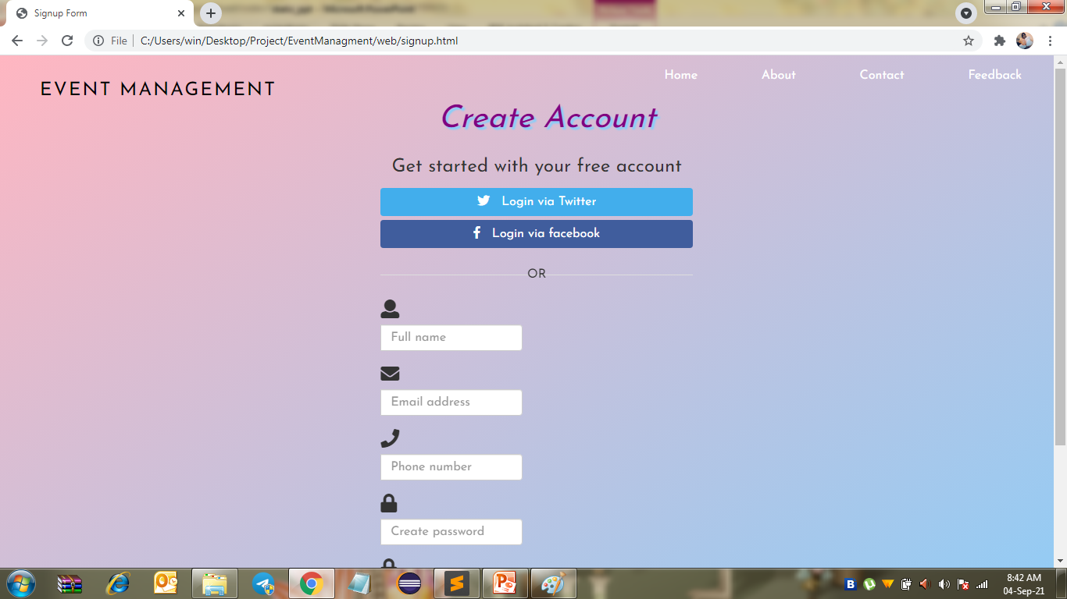
Sign Up Page:

Slide 11
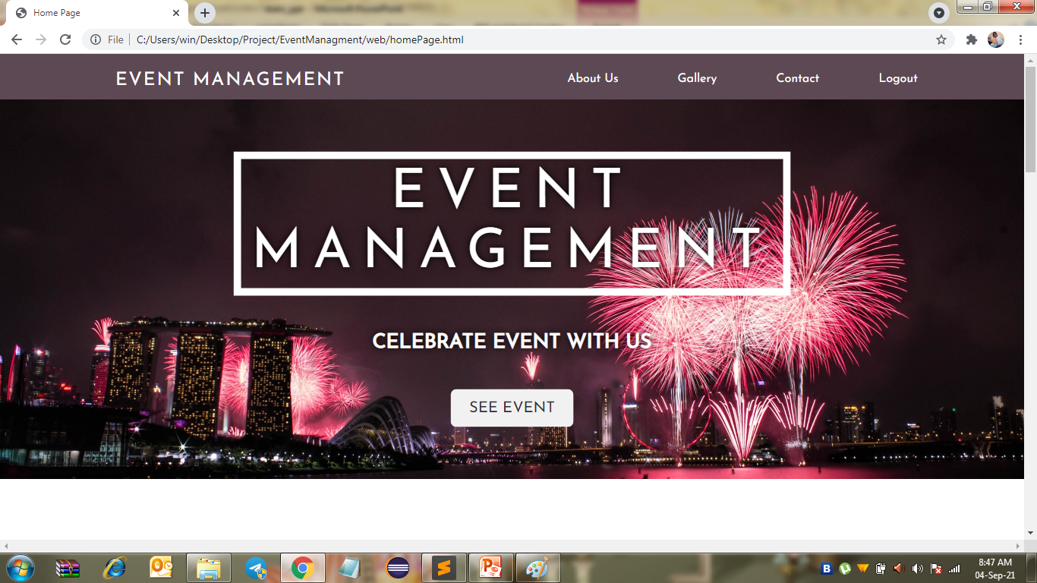
Home Page:

Slide 12
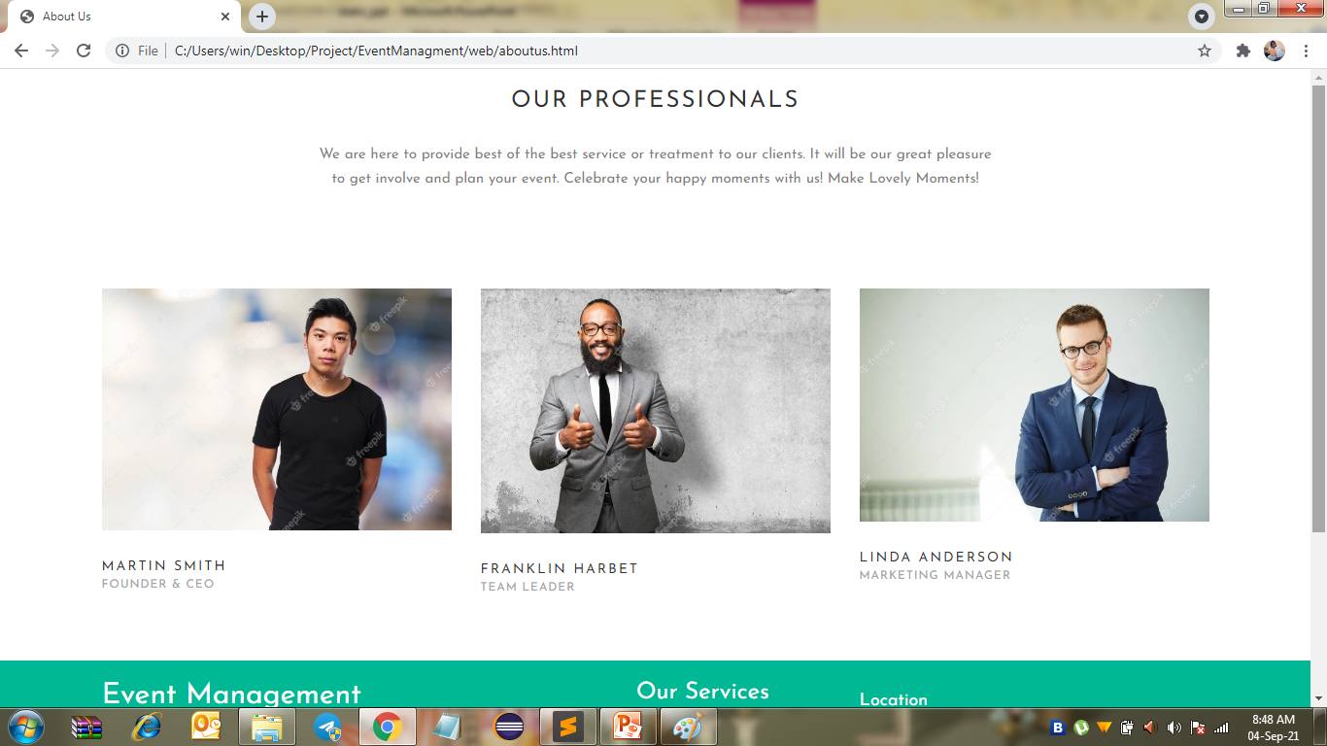
About US Page:

Slide 13
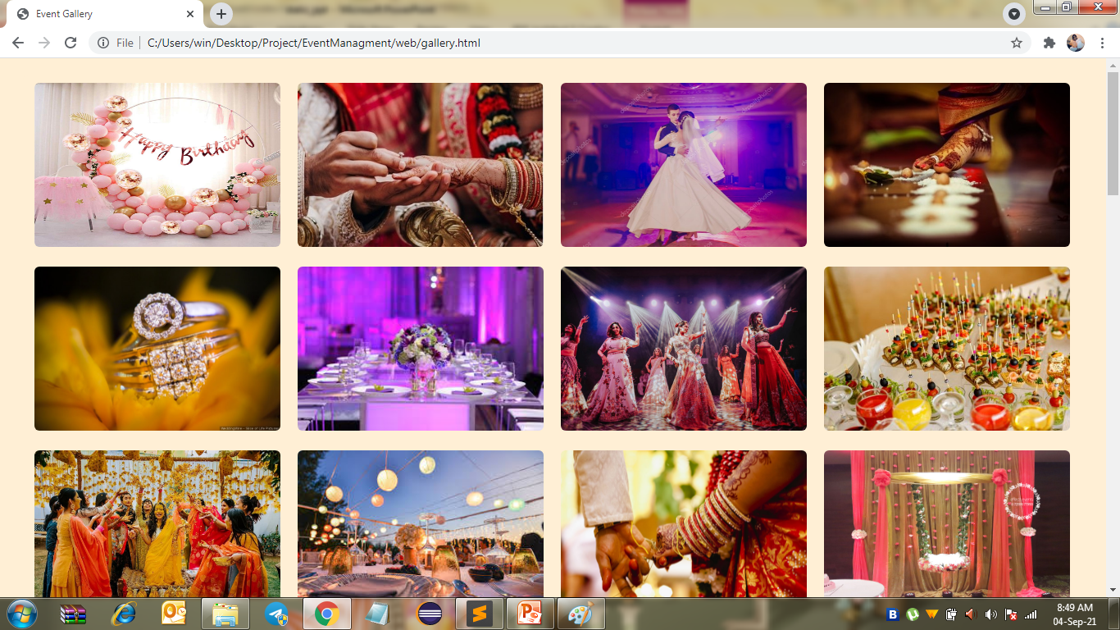
Gallery Page:

Slide 14
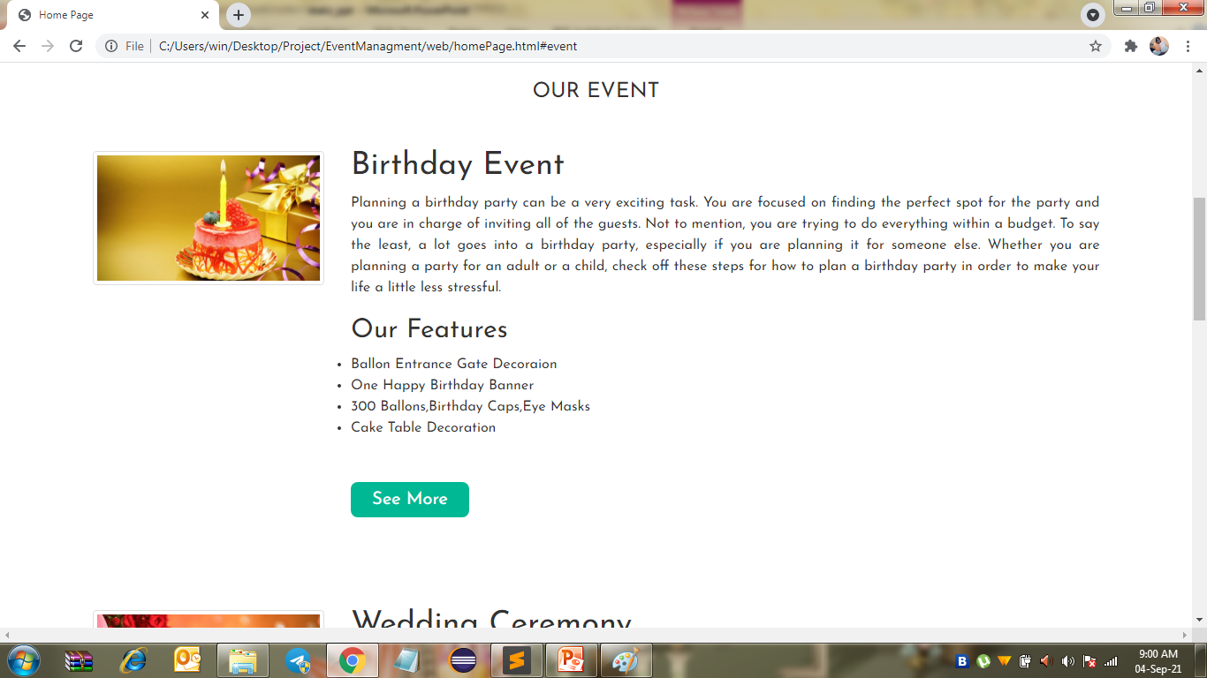
See Event Section:

Slide 15
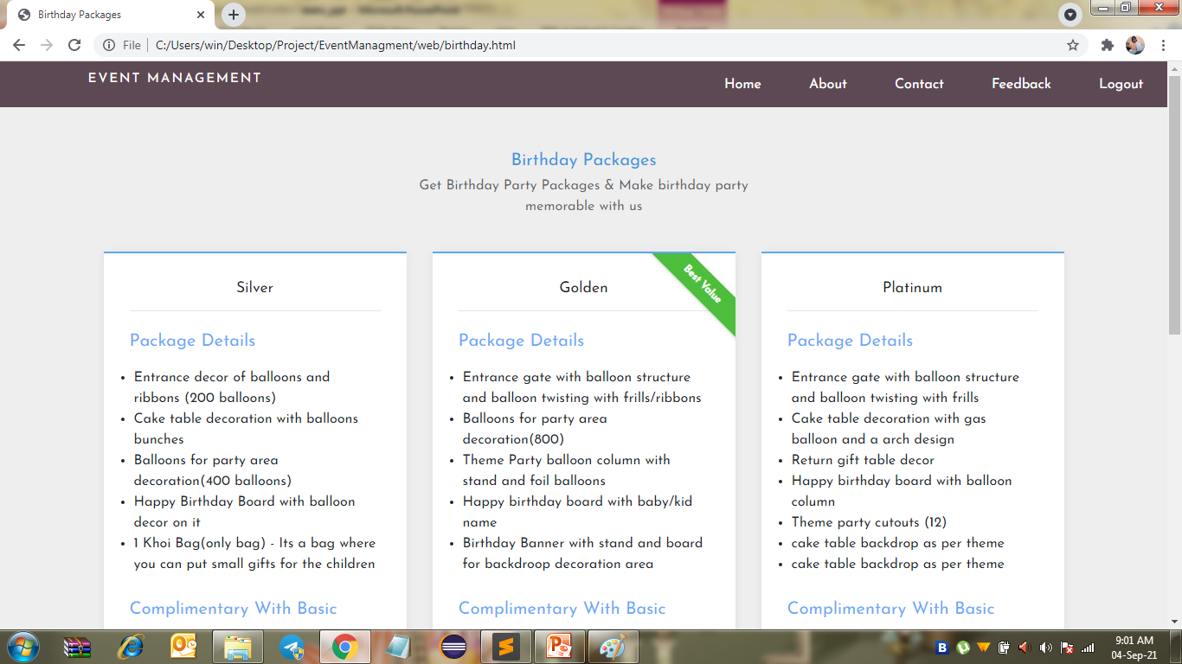
See More Section:

Slide 16
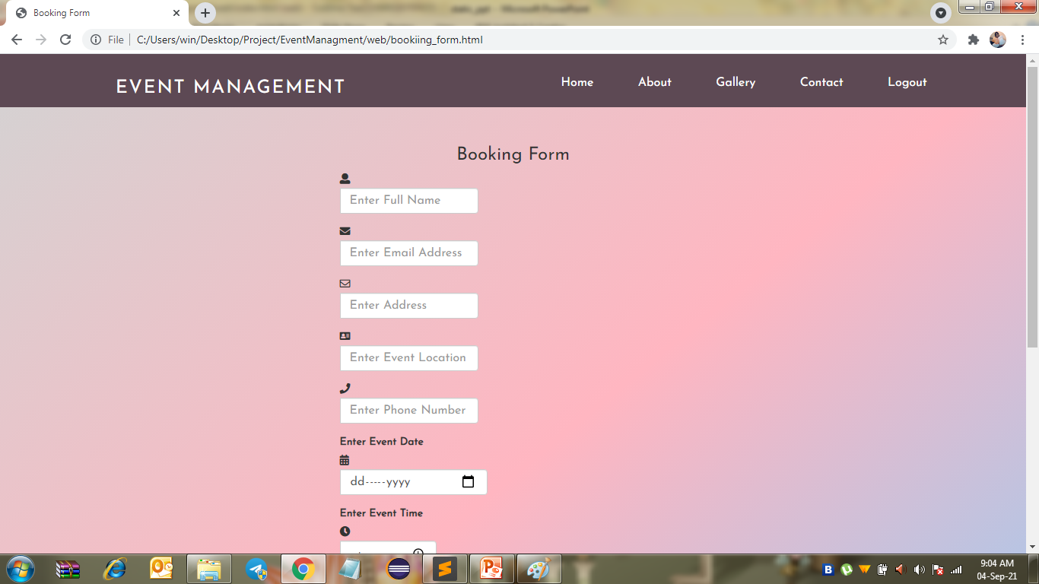
Booking Form Page:

Slide 17
Conclusion:
The purpose of this website is to make user friendly website
for Event Management where user can easily use it.

Slide 18
Thank You…

